Slide 1
3D-Virtual Reality
Who do I Direct MATLAB to use OpenGL on MATLAB environment

Slide 2
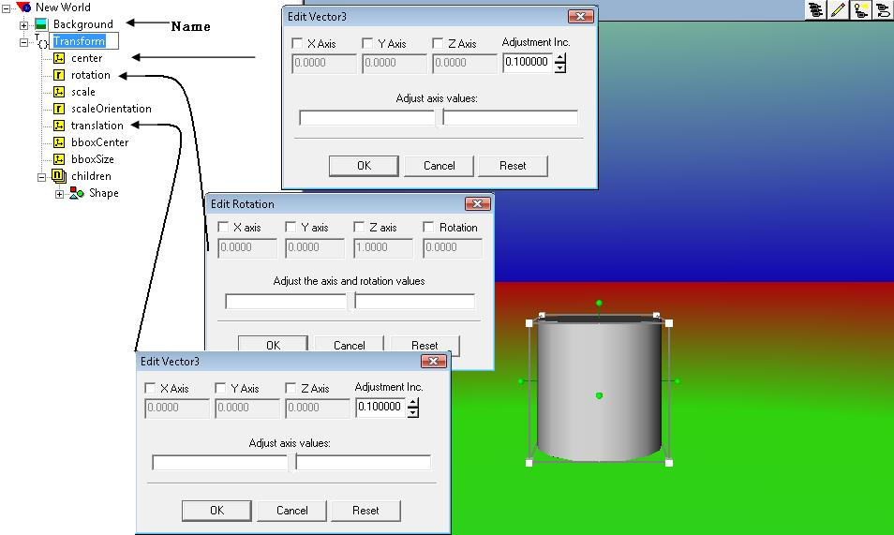
Add an Object TO VR Environment

Slide 3
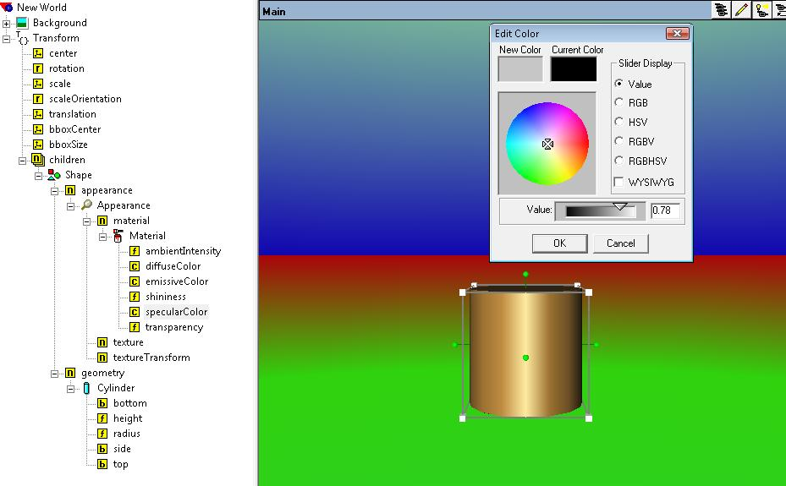
SpecularColor and DifuseColor Property

Slide 4
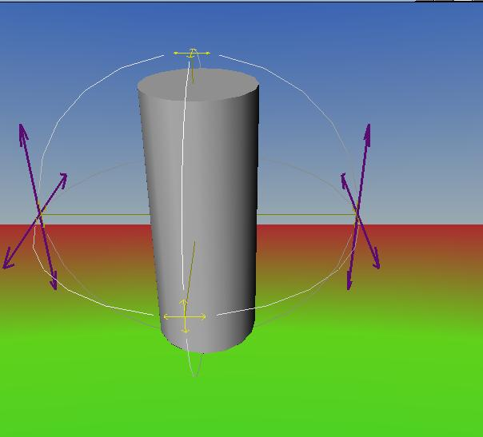
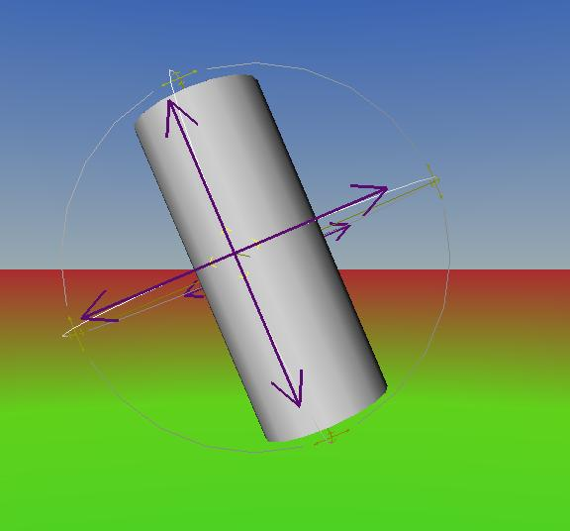
X,Y, and Z axes of Rotation
Rotation about X-Axis
Rotation about Z-Axis

Slide 5
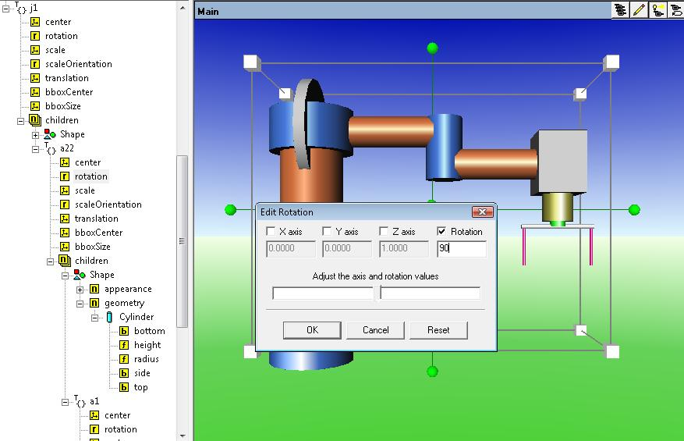
Rotation’s hidden object for a1

Slide 6
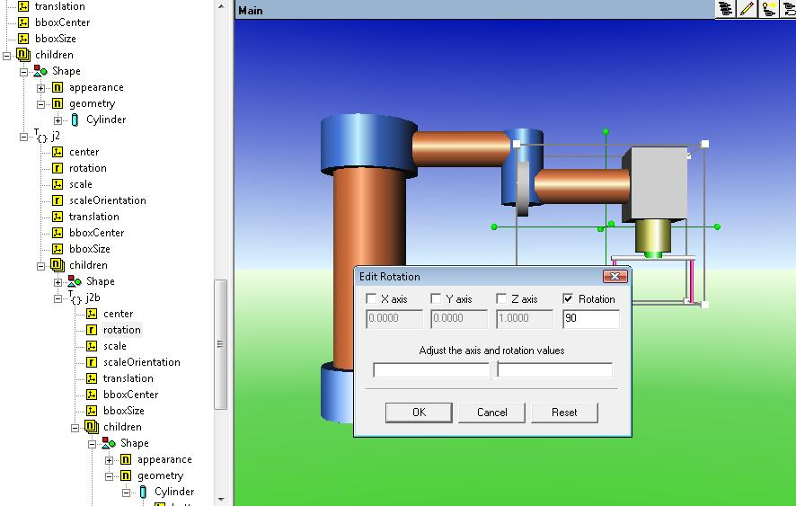
Rotation’s hidden object for a2

Slide 7
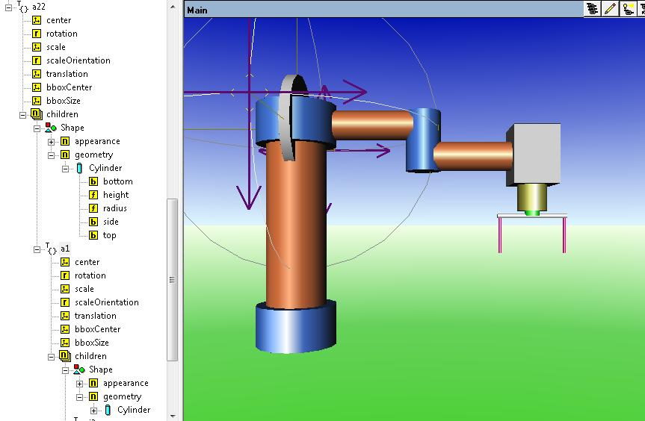
Axis of rotation for a1

Slide 8
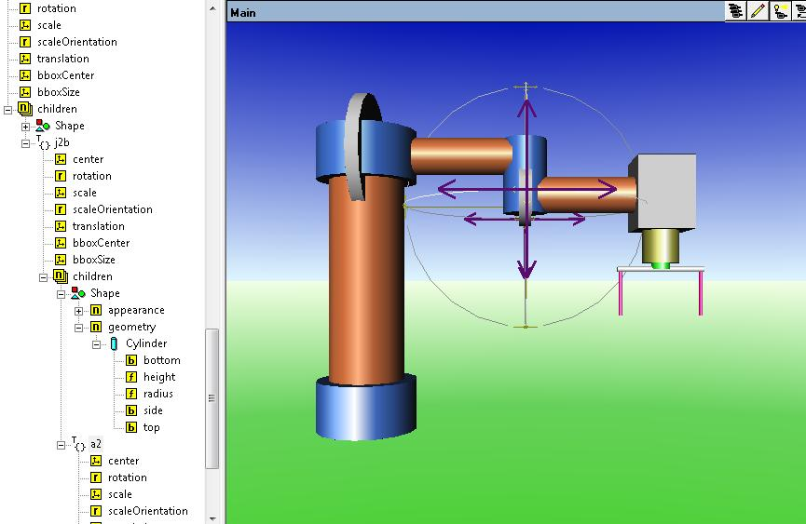
Axis of Rotation for a2

Slide 9
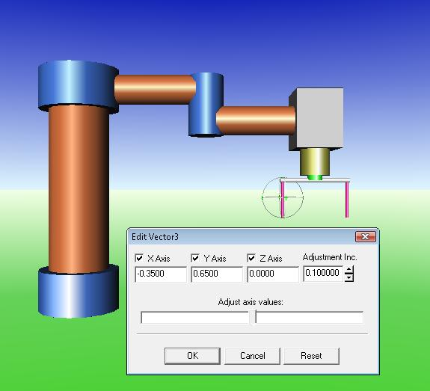
EndEffector

Slide 10
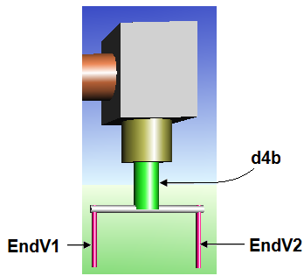
Controlling by commands
SCARA30 = vrworld('SCARA30.wrl');
open(SCARA30)
View(SCARA30)
radian=T1*pi/180, radian=-T2*pi/180, radian=T4*pi/180;
SCARA30.a1.rotation = [1, 0, 0, radian]
SCARA30.a2.rotation = [1, 0, 0, radian];
SCARA30.d4b.rotation = [0, 1, 0, radian]
SCARA30.d4b.translation = [0, d4b, 0];
EndV1=SCARA30.EndV1.translation;
EndV2=SCARA30.EndV2.translation;
x1=EndV1(1);
x2=EndV2(1);
y1=-.5*dist;
y2=.5*dist;
SCARA30.EndV1.translation = [x1, y1, 0];
SCARA30.EndV2.translation = [x2, y2, 0];

